Slide 1

Is High-Frequency Chest Wall Oscillation a more effective treatment than lung transplants for patients diagnosed with Cystic Fibrosis?
By Gideon
Manuel

Slide 2
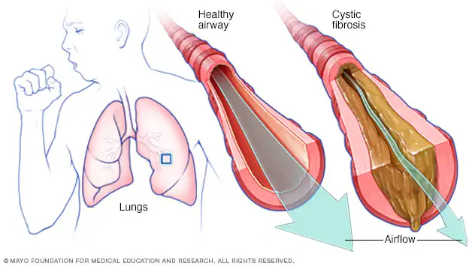
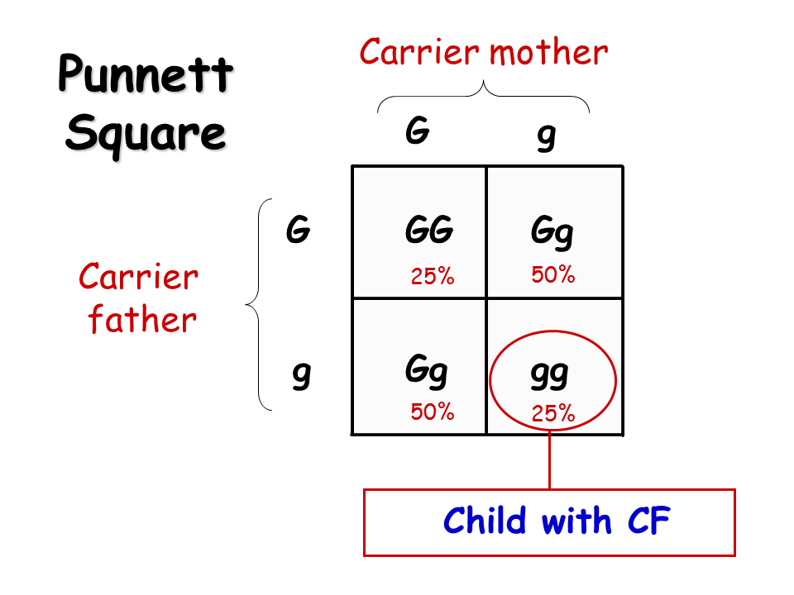
What is Cystic Fibrosis?
Cystic Fibrosis (CF) is an inherited disease responsible for the build-up of mucus within the lungs and the digestive system.
The disease is caused by a mutation within the CFTR gene (Cystic fibrosis transmembrane conductance regulator).
CF is a recessive disease. One copy of the faulty CFTR gene is inherited from both parents. The offspring would therefore have a 25% chance of inheriting the disease.
Figure. B
Currently, there’s no cure for the disease. But there are treatments and therapies which include:
- Medications like antibiotics
- Airway-clearance devices
- Lung Transplants
- Dietary advice
Around 10,800 people have CF in the UK (1 in every 2,500 babies born). Globally, CF affects roughly 100,000 people.
Figure. A
Notes:
Reference for Figure A- Twowomensci (2019) Cystic fibrosis: The disease that changed our family forever, Two Women Scientists. Available at: https://twowomensci.wordpress.com/2019/04/21/cystic-fibrosis-the-disease-that-changed-our-family-forever/ (Accessed: 23 November 2023).
Reference for Figure B - Cystic fibrosis (2021) Mayo Clinic. Available at: https://www.mayoclinic.org/diseases-conditions/cystic-fibrosis/symptoms-causes/syc-20353700 (Accessed: 23 November 2023).

Slide 3
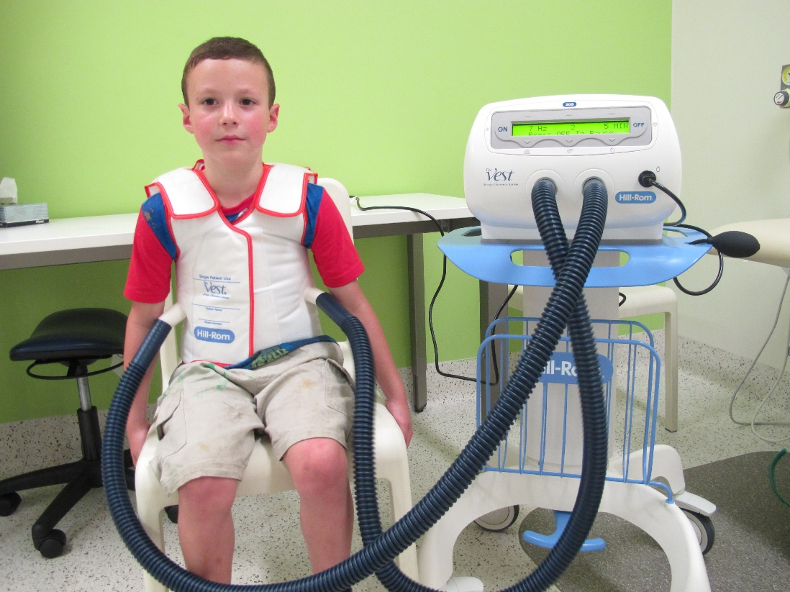
High-Frequency Chest Wall Oscillation
A brief History of the treatment
At the University of Minnesota, researchers developed a device to replace manual chest percussion therapy in 1985, where the device would help clear mucus secretions from the lungs of CF patients. This new device was the birth of HFCWO.
What is HFCWO?
HFCWO is an airway clearance technique in which external chest wall oscillations are applied to the chest using an inflatable vest that wraps around the chest.
Figure. A
How it is operated
An inflatable vest is attached to an air pulse generator.
The air-pulse generator sends air through a hose to the inflatable vest, allowing the vest to rapidly inflate and deflate (vibrating at a rapid pace), roughly 20 times per second.
This vibrating process allows the chest to loosen and thin mucus that’s trapped within the lungs.
This would cause the patient to cough up the mucus, roughly every 5 minutes, due to the pressure created by the vibrating vest.
Notes:
Reference for Figure A - High frequency chest wall oscillation (2022) Bronchiectasis. Available at: https://bronchiectasis.com.au/paediatrics/airway-clearance/high-frequency-chest-wall-oscillation (Accessed: 09 November 2023).

Slide 4
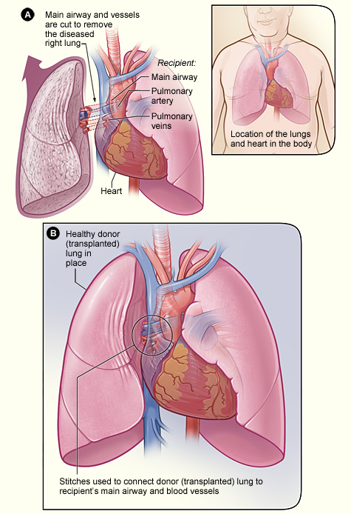
Lung Transplants
Lung transplants are where one/both lung(s) are removed from the patient through surgery and are replaced with lung implants of the chosen donor(s). The donor(s) and the patient need to have matching blood groups.
Figure. A
Notes:
Reference for Figure. A - Lung Transplantation (2023) Wikipedia. Available at: https://en.wikipedia.org/wiki/Lung_transplantation (Accessed: 09 November 2023).

Slide 5
So which one is more effective?
HFCWO
It has been found that HFCWO provides physiological mechanisms by which secretions in the lungs are loosened from the airway wall and moved proximally in the respiratory tree. To support this, Tomkiewicz et al. were able to demonstrate an in vitro reduction in both spinnability of mucus and its viscoelasticity (a substance exhibiting both elastic and viscous behaviour) properties. They found that ‘the mucus material became more fluid, and more easily cleared from the airway.
A downside to using HFCWO is its practicality. The device is heavy and not very portable. If a patient were to use it by themselves, they may struggle to move it around to their desired position.
Lung Transplants
The main benefits of lung transplants for CF patients are an increased life expectancy and a better quality of life. They found that that ‘The median survival of Cf patients after lung transplant is 8.3 years. From this, we can take that lung transplants are a vital method of treatment for patients diagnosed with CF. However, 8.3 years can be considered short, so it can be debated whether lung transplants are considered effective.
The main risks of lung transplants include a high risk of dying in the first few months after the operation, and that the procedure comes with surgical risks (e.g., bleeding). There is therefore question on whether patients would opt for this method of treatment, other than HFCWO.
Conclusion
HFCWO can be considered a more suitable treatment.
It can make symptoms of CF more bearable, and there’s evidential support for its ability to loosen up mucus, but its practicality can be debatable in terms of one person handling the setup themselves.
Lung transplants can increase a patient’s life expectancy, but vitally, the first few months of a successful transplant results in higher chances of death.

